Slide 1
Operating System [ 4th-Semester]

Slide 2
Deadlocks

Slide 3
Contents
Introduction, Deadlock Characterization, Preemptable and Non-preemptable Resources, Resource – Allocation Graph, Conditions for Deadlock .
Handling Deadlocks: Ostrich Algorithm, Deadlock prevention, Deadlock Avoidance, Deadlock Detection (For Single and Multiple Resource Instances), Recovery From Deadlock (Through Preemption and Rollback)

Slide 4
Resources
Examples of computer resources
printers
tape drives
Tables
Resource can be:
Hardware device;
Piece of information;
Processes need access to resources in reasonable order
Suppose a process holds resource A and requests resource B
at same time another process holds B and requests A
both are blocked and remain so

Slide 5
Abstract sequence of events required to use a resource:
Request the resource.
Use the resource.
Release the resource.

Slide 6
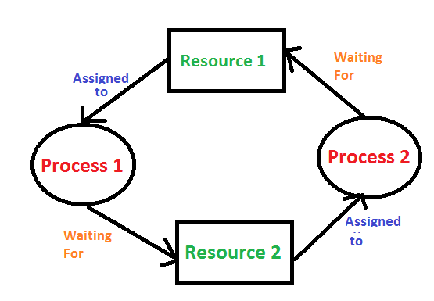
Deadlock
Deadlock is a situation where a set of processes are blocked because each process is holding a resource and waiting for another resource acquired by some other process.
Consider an example when two trains are coming toward each other on the same track and there is only one track, none of the trains can move once they are in front of each other. A similar situation occurs in operating systems when there are two or more processes that hold some resources and wait for resources held by other(s).

Slide 7
Four Conditions for Deadlock
1. Mutual exclusion condition. Each resource is either currently assigned to exactly one process or is available.
2. Hold-and-wait condition. Processes currently holding resources that were granted earlier can request new resources.
3. No-preemption condition. Resources previously granted cannot be forcibly taken away from a process. They must be explicitly released by the process holding them.
4. Circular wait condition. There must be a circular list of two or more processes, each of which is waiting for a resource held by the next member of the chain.

Slide 8
Methods for Handling Deadlocks
Deadlock Prevention
Ensure that at least one of four necessary conditions cannot hold
Deadlock Avoidance
Do not allow a resource request → Potential to lead to a deadlock
Requires advance info of all requests
Deadlock Detection
Always allow resource requests
Periodically check for deadlocks
If a deadlock exists → Recover from it
Ignore
Makes sense if the likelihood is very low, say once per year
Cheaper than prevention, avoidance or detection
Used by most common OS

Slide 9
Deadlock Ignorance(The ostrich algorithm)
Ostrich algorithm:
Stick your head in the sand and pretend there is no problem;
People react to this strategy in different ways:
Unix and windows system
Cost of detection is high
How often is the problem expected?
How often the system crashes for other reasons?
How serious a deadlock is?

Slide 10
For example, a compilation can always be rerun because all it does is read a source file and produce an object file. If it is killed partway through, the first run has no influence on the second run.

Slide 11
Deadlock Prevention
Resource allocation rules prevent deadlock by prevent one of the four conditions required for deadlock from occurring
Mutual exclusion
Hold and wait
No preemption
Circular Wait

Slide 12
1. Attacking the Mutual Exclusion Condition
Allow everybody to use the resources immediately they require!
By spooling printer output, several processes can generate output at the same time.
In this model, the only process that actually requests the physical printer is the printer daemon. Since the daemon never requests any other resources, we can eliminate deadlock for the printer.

Slide 13
2. Attacking the Hold and Wait Condition
Require processes to request resources before starting
a process never has to wait for what it needs
Problems
may not know required resources at start of run
also ties up resources other processes could be using
Variation:
process must give up all resources
then request all immediately needed

Slide 14
3. No Preemption
If a process that is holding some resources requests another resource that cannot be immediately allocated to it, then all resources currently being held are released
Not realistic for many types of resources, such as printers
4. Circular Wait
Impose a total ordering of all resource types
Each process requests resources in an increasing order of enumeration

Slide 15
Deadlock avoidance
Instead of detecting deadlock, can we simply avoid it?
– YES, but only if enough information is available in advance.
Maximum number of each resource required
Resource Trajectories
The main algorithms for deadlock avoidance are based on the concept of safe states.
Graphical approach does not translate directly into a usable algorithm, it gives a good intuitive feel for the nature of the problem.

Slide 16
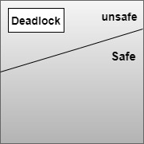
Safe State and Unsafe State
A state is safe if the system can allocate resources to each process( up to its maximum requirement) in some order and still avoid a deadlock.
In an Unsafe state, the operating system cannot prevent processes from requesting resources in such a way that any deadlock occurs.

Slide 17
Processes | Maximum Needs | Current Needs
P1 | 10 | 5
P2 | 4 | 2
P3 | 9 | 2
Let us consider a system having 12 magnetic tapes and three processes P1, P2, P3. Process P1 requires 10 magnetic tapes, process P2 may need as many as 4 tapes, process P3 may need up to 9 tapes. Suppose at a time to, process P1 is holding 5 tapes, process P2 is holding 2 tapes and process P3 is holding 2 tapes. (There are 3 free magnetic tapes)
The sequence is <P2,P1,P3> satisfies the safety condition.

Slide 18
Banker’s Algorithm in Operating System
The banker’s algorithm is a resource allocation and deadlock avoidance algorithm that tests for safety by simulating the allocation for predetermined maximum possible amounts of all resources, then makes an “s-state” check to test for possible activities, before deciding whether allocation should be allowed to continue

Slide 19
Data Structures for the Banker’s Algorithm
Let n = number of processes, and m = number of resources types.
Available: Vector of length m. If available [j] = k, there are k instances of resource type R_{j} available
Max: n x m matrix. If Max [i,j] = k, then process P_{i} may request at most k instances of resource type R_{j}
Allocation: n x m matrix. If Allocation[i,j] = k then P_{i} is currently allocated k instances of R_{j}
Need: n x m matrix. If Need[i,j] = k, then P_{i} may need k more instances of R_{j} to complete its task
Need [i,j] = Max[i,j] – Allocation [i,j]

Slide 20
Resource-Request Algorithm for Process P_{i}
Request_{i} = request vector for process P_{i}. If Request_{i} [j] = k then process P_{i} wants k instances of resource type R_{j}
1. If Request_{i} ≤ Need_{i} go to step 2. Otherwise, raise error condition, since process has exceeded its maximum claim
2. If Request_{i} ≤ Available, go to step 3. Otherwise P_{i} must wait, since resources are not available
3. Pretend to allocate requested resources to P_{i} by modifying the state as follows:
Available = Available – Request_{i};
Allocation_{i} = Allocation_{i} + Request_{i};
Need_{i} = Need_{i} – Request_{i};
If safe ⇒ the resources are allocated to P_{i}
If unsafe ⇒ P_{i} must wait, and the old resource-allocation state is restored

Slide 21
Example :2 Consider a system that contains five processes P1, P2, P3, P4, P5 and the three resource types A, B and C. Following are the resources types: A has 10, B has 5 and the resource type C has 7 instances.
Answer the following questions using the banker's algorithm:
What is the reference of the need matrix?
Determine if the system is safe or not.
Process | Allocation A B C | Max A B C | Available A B C
P1 | 0 1 0 | 7 5 3 | 3 3 2
P2 | 2 0 0 | 3 2 2
P3 | 3 0 2 | 9 0 2
P4 | 2 1 1 | 2 2 2
P5 | 0 0 2 | 4 3 3

Slide 22
Ans. 1: Context of the need matrix is as follows:
Need [i] = Max [i] – Allocation/Has [i]
Need for P1: (7, 5, 3) - (0, 1, 0) = 7, 4, 3
Need for P2: (3, 2, 2) - (2, 0, 0) = 1, 2, 2
Need for P3: (9, 0, 2) - (3, 0, 2) = 6, 0, 0
Need for P4: (2, 2, 2) - (2, 1, 1) = 0, 1, 1
Need for P5: (4, 3, 3) - (0, 0, 2) = 4, 3, 1
Process | Need A B C
P1 | 7 4 3
P2 | 1 2 2
P3 | 6 0 0
P4 | 0 1 1
P5 | 4 3 1

Slide 23
Ans. 2: Apply the Banker's Algorithm: Available Resources of A, B and C are 3, 3, and 2. Now we check if each type of resource request is available for each process.
Step 1: For Process P1:
Need <= Available
7, 4, 3 <= 3, 3, 2 condition is false.
So, we examine another process, P2.
Step 2: For Process P2:
Need <= Available
1, 2, 2 <= 3, 3, 2 condition true
New available = available + Allocation
(3, 3, 2) + (2, 0, 0) => 5, 3, 2
Similarly, we examine another process P3.

Slide 24
Step 3: For Process P3:
P3 Need <= Available
6, 0, 0 < = 5, 3, 2 condition is false.
Similarly, we examine another process, P4.
Step 4: For Process P4:
P4 Need <= Available
0, 1, 1 <= 5, 3, 2 condition is true
New Available resource = Available + Allocation
5, 3, 2 + 2, 1, 1 => 7, 4, 3
Similarly, we examine another process P5.
Step 5: For Process P5:
P5 Need <= Available
4, 3, 1 <= 7, 4, 3 condition is true
New available resource = Available + Allocation
7, 4, 3 + 0, 0, 2 => 7, 4, 5
Now, we again examine each type of resource request for processes P1 and P3.

Slide 25
Step 6: For Process P1:
P1 Need <= Available
7, 4, 3 <= 7, 4, 5 condition is true
New Available Resource = Available + Allocation
7, 4, 5 + 0, 1, 0 => 7, 5, 5
So, we examine another process P2.
Step 7: For Process P3:
P3 Need <= Available
6, 0, 0 <= 7, 5, 5 condition is true
New Available Resource = Available + Allocation
7, 5, 5 + 3, 0, 2 => 10, 5, 7
Hence, we execute the banker's algorithm to find the safe state and the safe sequence : P2, P4, P5, P1 and P3.

Slide 26
Example of Banker’s Algorithm
Consider the following snapshot of a system:
Processes | Allocation A B C | Max A B C | Available A B C
P₀ | 1 1 2 | 4 3 3 | 2 1 0
P₁ | 2 1 2 | 3 2 2
P₂ | 4 0 1 | 9 0 2
P₃ | 0 2 0 | 7 5 3
P₄ | 1 1 2 | 1 1 2
calculate the content of the need matrix?
Is the system in a safe state?
Determine the total amount of resources of each type?

Slide 27
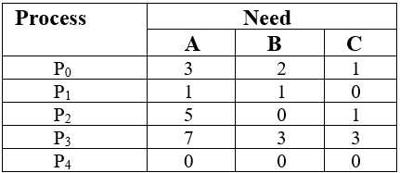
Solution:
1. Content of the need matrix can be calculated by using the below formula
Need = Max – Allocation

Slide 28
2. Now, we check for a safe state
Safe sequence:
For process P₀, Need = (3, 2, 1) and
Available = (2, 1, 0)
Need ≤ Available = False
So, the system will move for the next process.
2. For Process P_{1,} Need = (1, 1, 0)
Available = (2, 1, 0)
Need ≤ Available = True
Request of P₁ is granted.
⸫ Available = Available +Allocation
= (2, 1, 0) + (2, 1, 2)
= (4, 2, 2) (New Available)
3. For Process P₂, Need = (5, 0, 1)
Available = (4, 2, 2)
Need ≤ Available = False
So, the system will move to the next process.
4. For Process P_{3,} Need = (7, 3, 3)
Available = (4, 2, 2)
Need ≤ Available = False
So, the system will move to the next process.

Slide 29
5. For Process P₄, Need = (0, 0, 0)
Available = (4, 2, 2)
Need ≤ Available = True
Request of P₄ is granted.
⸫ Available = Available + Allocation
= (4, 2, 2) + (1, 1, 2)
= (5, 3, 4) now, (New Available)
6. Now again check for Process P_{2,} Need = (5, 0, 1)
Available = (5, 3, 4)
Need ≤ Available = True
Request of P₂ is granted.
⸫ Available = Available + Allocation
= (5, 3, 4) + (4, 0, 1)
= (9, 3, 5) now, (New Available)
7. Now again check for Process P₃, Need = (7, 3, 3)
Available = (9, 3, 5)
Need ≤ Available = True
Request of P₃ is granted.
⸫ Available = Available +Allocation
= (9, 3, 5) + (0, 2, 0) = (9, 5, 5)
8. Now again check for Process P₀, = Need (3, 2, 1)
= Available (9, 5, 5)
Need ≤ Available = True
So, the request will be granted to P₀.
Safe sequence: < P_{1,} P_{4,} P_{2,} P_{3,} P_{0>}

Slide 30
Deadlock detection

Slide 31
Resource Allocation Graph (RAG)
resource allocation graph is explained to us what is the state of the system in terms of processes and resources. Like how many resources are available, how many are allocated and what is the request of each process. Everything can be represented in terms of the diagram. One of the advantages of having a diagram is, sometimes it is possible to see a deadlock directly by using RAG, but then you might not be able to know that by looking at the table.
1. Process vertex – Every process will be represented as a process vertex. Generally, the process will be represented with a circle. 2. Resource vertex – Every resource will be represented as a resource vertex. It is also two type –
Single instance type resource – It represents as a box, inside the box, there will be one dot. So the number of dots indicate how many instances are present of each resource type.
Multi-resource instance type resource – It also represents as a box, inside the box, there will be many dots present.

Slide 32
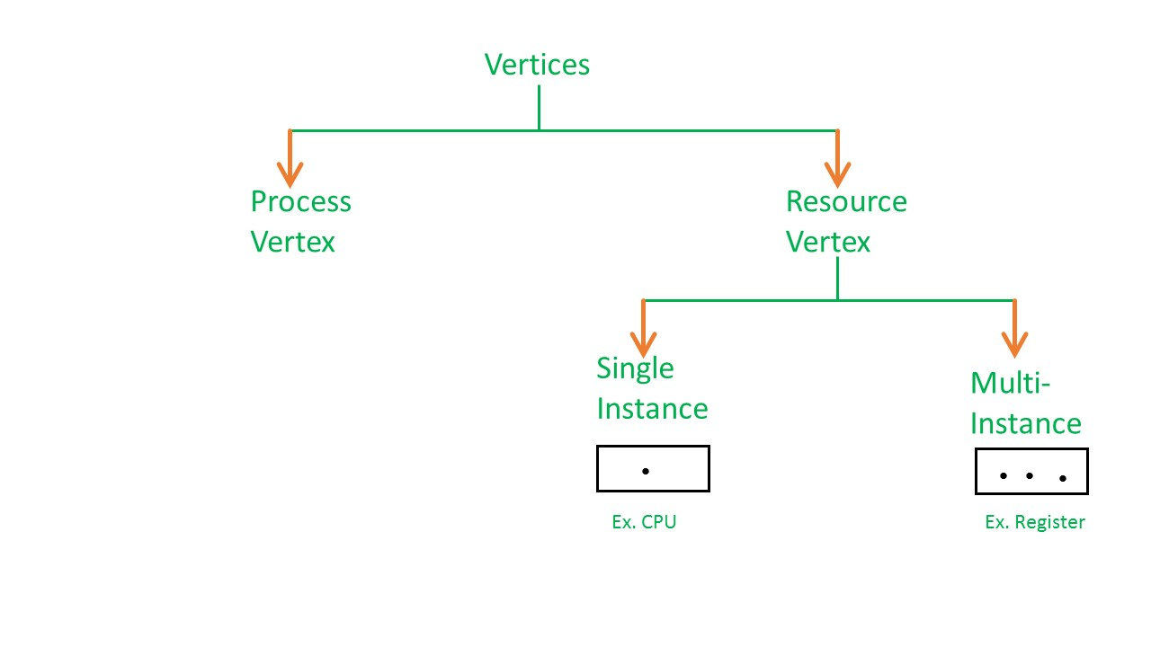
Resource Allocation Graph (RAG)

Slide 33
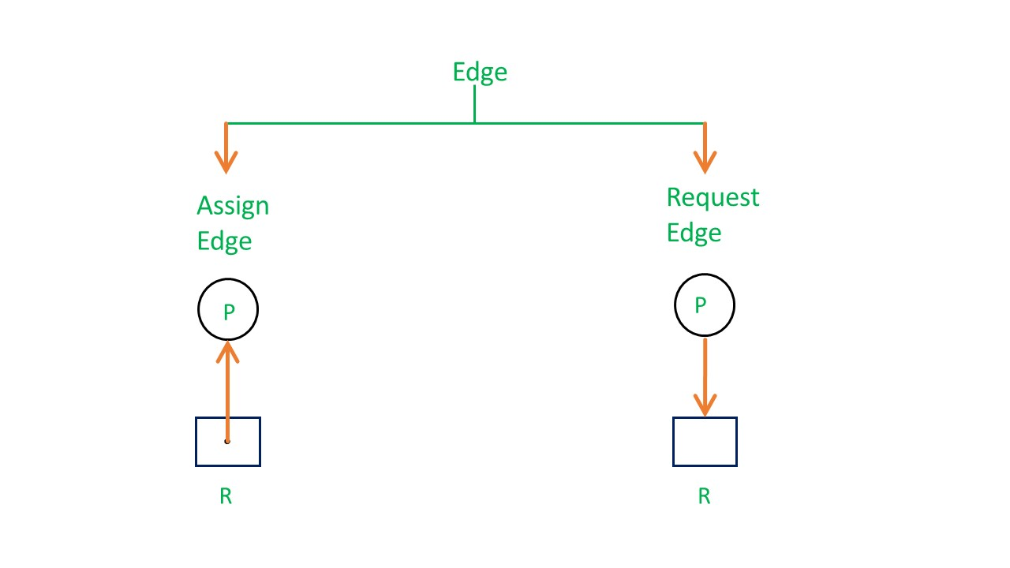
Edges of RAG.
Assign Edge – If you already assign a resource to a process then it is called Assign edge. 2. Request Edge – It means in future the process might want some resource to complete the execution, that is called request edge.

Slide 34
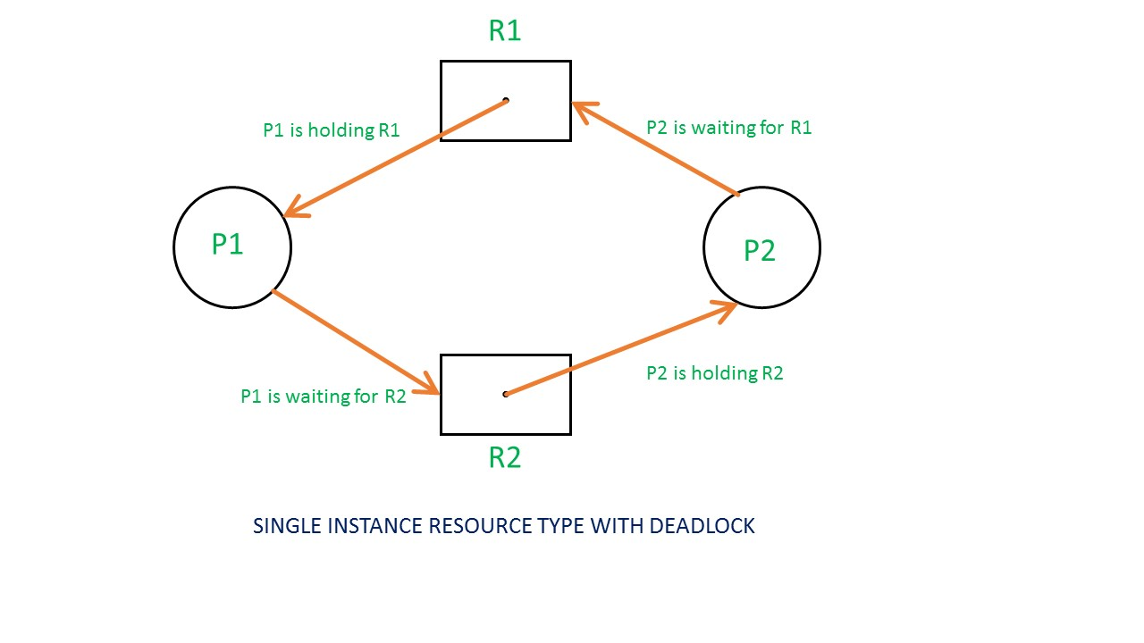
Example 1 (Single instances RAG)

Slide 35
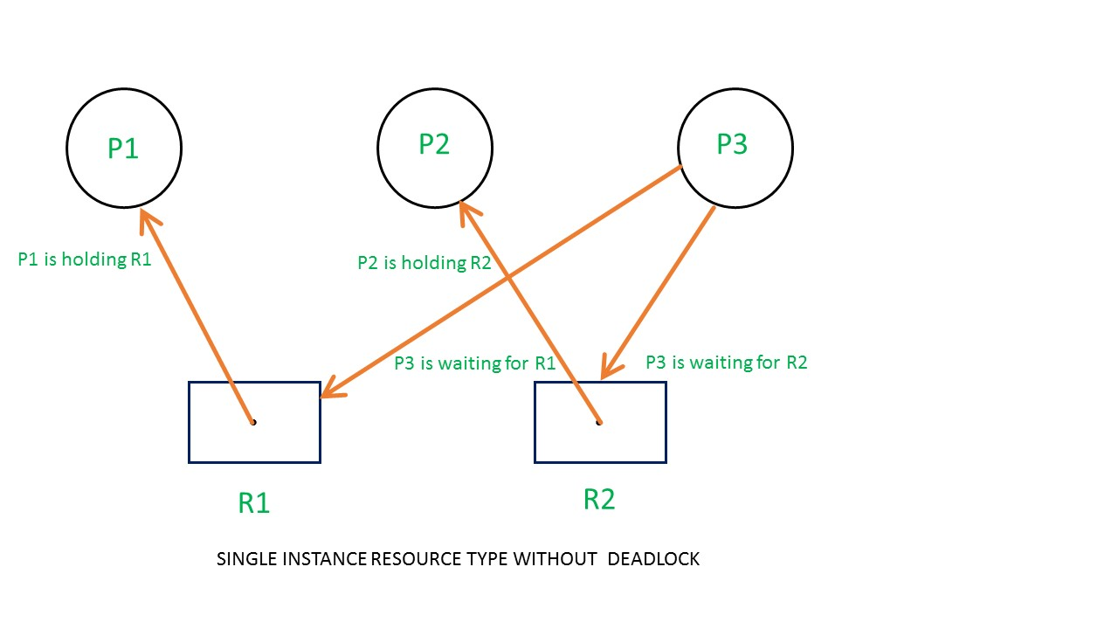
Example 1 (Single instances RAG)
If there is a cycle in the Resource Allocation Graph and each resource in the cycle provides only one instance, then the processes will be in deadlock. For example, if process P1 holds resource R1, process P2 holds resource R2 and process P1 is waiting for R2 and process P2 is waiting for R1, then process P1 and process P2 will be in deadlock.

Slide 36
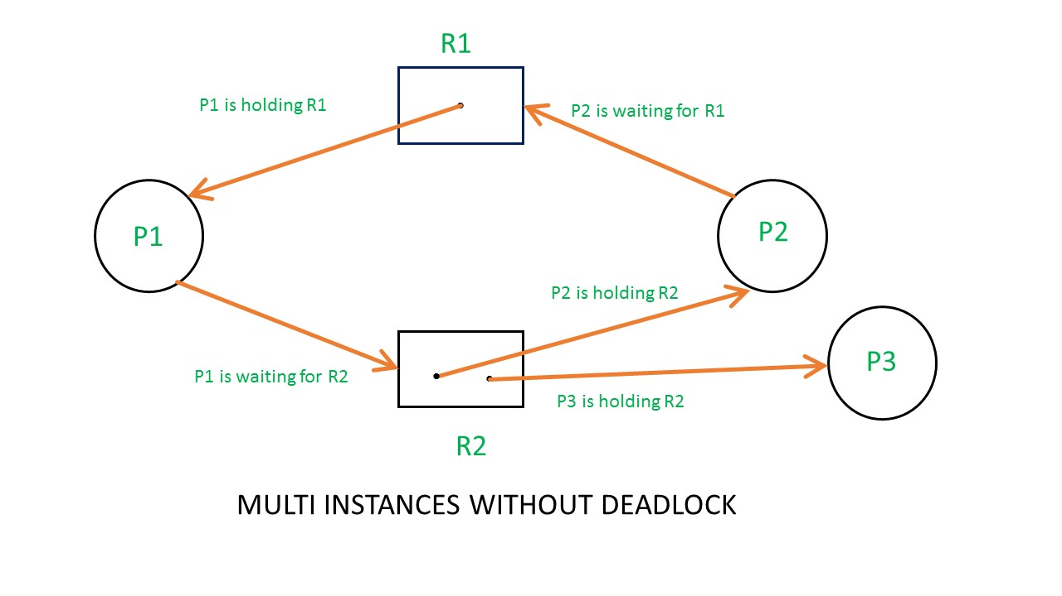
Multi instances

Slide 37
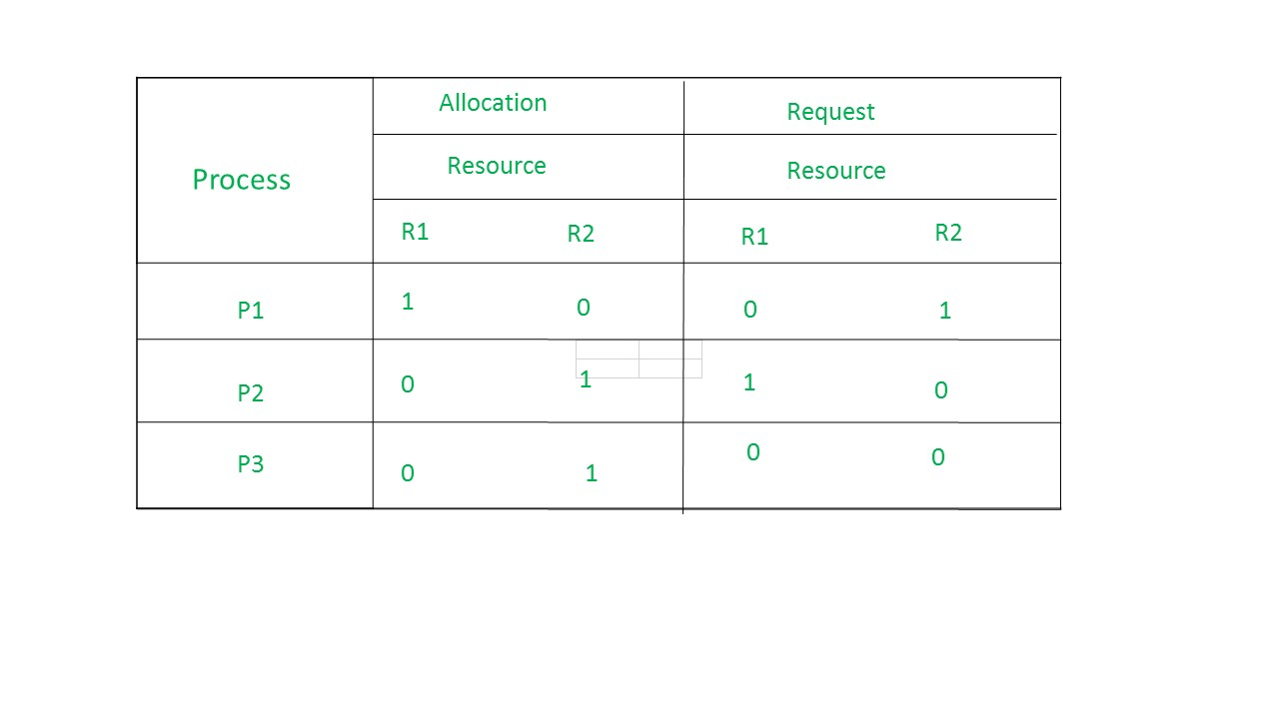
Example 2 (Multi-instances RAG)
The total number of processes are three; P1, P2 & P3 and the total number of resources are two; R1 & R2.
llocation matrix –
For constructing the allocation matrix, just go to the resources and see to which process it is allocated.
R1 is allocated to P1, therefore write 1 in allocation matrix and similarly, R2 is allocated to P2 as well as P3 and for the remaining element just write 0.
Request matrix –
In order to find out the request matrix, you have to go to the process and see the outgoing edges.
P1 is requesting resource R2, so write 1 in the matrix and similarly, P2 requesting R1 and for the remaining element write 0.So now available resource is = (0, 0).

Slide 38
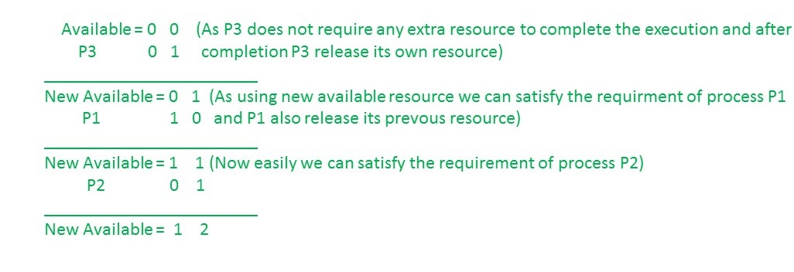
Checking deadlock (safe or not)
So, there is no deadlock in this RAG. Even though there is a cycle, still there is no deadlock. Therefore in multi-instance resource cycle is not sufficient condition for deadlock.

Slide 39
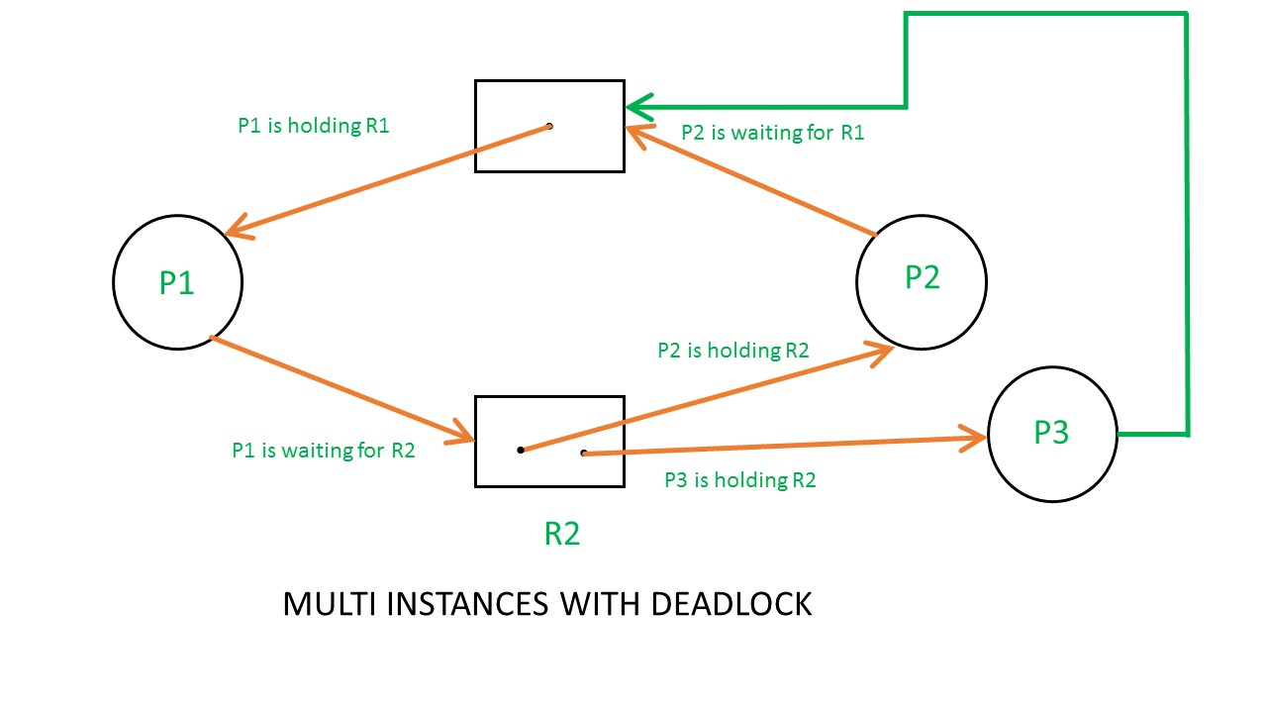
Multi instances with deadlock

Slide 40

Multi instances with deadlock
Above example is the same as the previous example except that, the process P3 requesting for resource R1.
So,the Available resource is = (0, 0), but requirement are (0, 1), (1, 0) and (1, 0).So you can’t fulfill any one requirement. Therefore, it is in deadlock.
Therefore, every cycle in a multi-instance resource type graph is not a deadlock, if there has to be a deadlock, there has to be a cycle. So, in case of RAG with multi-instance resource type, the cycle is a necessary condition for deadlock, but not sufficient.

Slide 41
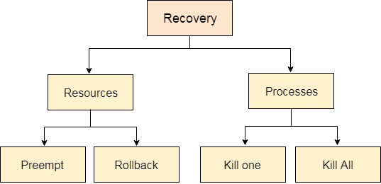
Deadlock Recovery
In this approach, The OS doesn't apply any mechanism to avoid or prevent the deadlocks. Therefore the system considers that the deadlock will definitely occur. In order to get rid of deadlocks, The OS periodically checks the system for any deadlock. In case, it finds any of the deadlock then the OS will recover the system using some recovery techniques.

Slide 42
Deadlock Recovery
For resource
Preempt the resource
We can snatch one of the resources from the owner of the resource (process) and give it to the other process with the expectation that it will complete the execution and will release this resource sooner. Well, choosing a resource which will be snatched is going to be a bit difficult.
Rollback to a safe state
System passes through various states to get into the deadlock state. The operating system can rollback the system to the previous safe state. For this purpose, OS needs to implement check pointing at every state. The moment, we get into deadlock, we will rollback all the allocations to get into the previous safe state.

Slide 43
Deadlock Recovery
For process
Kill a process
Killing a process can solve our problem but the bigger concern is to decide which process to kill. Generally, Operating system kills a process which has done least amount of work until now.
Kill all process
This is not a suggestible approach but can be implemented if the problem becomes very serious. Killing all process will lead to inefficiency in the system because all the processes will execute again from starting.

